Slide 1

Verification
Testing

Slide 2
Verification Testing
Each verification activity is a phase of the testing life cycle.
Objective
To detect as many errors as possible.
The testing team should leverage its efforts by participating in any inspections and walkthroughs conducted by development and by initiating verification, especially at the early stages of development.
It has proven to be one of the surest and most cost-effective routes to quality improvement in both the short and the long term.

Slide 3
Verification Testing
Basic verification methods
Verification is a “human” examination or review of the work product. There are various types of reviews.
Inspections, walkthroughs, technical reviews and other methods are not always referred to consistently, but inspections are generally considered the most formal.

Slide 4
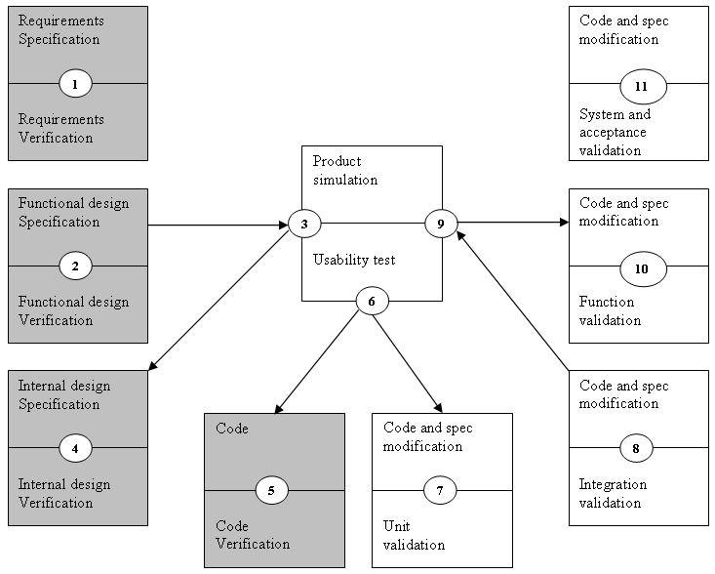
Verification Testing
The SDT Dotted-U Model, verification testing

Slide 5
Verification Testing
Formal structured types of verification
Formal reviews, technical reviews, and inspections are various expressions used for the more structured types of verification.

Slide 6
Verification Testing
Formal methods – key elements
Everyone in the review group participates openly and actively, and participation is governed by traditions, customs and written rules about how such a review is to be conducted.
2. A written report is produced regarding the status of the product, and the report is available to everyone involved in the project, including management.
3. The review group is responsible for the quality of information in the written report.

Slide 7
Verification Testing
Inspection: key elements and phases
Objectives:
to obtain defects and collect data; meeting does not examine alternative solutions;
to communicate important work product information.

Slide 8
Verification Testing
Elements:
a planned, structured meeting requiring individual preparation by all participants;
a team of 3-6 people, led by an impartial moderator;
presenter is “reader” other than the producer

Slide 9
Verification Testing
Input:
document to be inspected;
related source documents;
general and “tailored” checklists
Output:
inspection summary/report;
data on error types.

Slide 10
Verification Testing
The presenter in an inspection meeting is ideally not the producer or author of the document being inspected.
Tester participating in any kind of review see the product differently than developers: “How is this thing going to work? If I test it this way, what’s going to happen?”

Slide 11
Verification Testing
Walkthroughs
Walkthroughs are less formal than inspections mainly because of the lack of preparation. In walkthroughs the participants simply come to the meeting; the presenter prepares (usually the author of the product), and there’s no additional effort by the participants prior to the meeting.

Slide 12
Verification Testing
Walkthroughs: key elements
Objectives:
to detect defects and to become familiar with the material.
Elements:
a planned meeting where only the presenter must prepare;
a team of 2-7 people, led by the producer/author;
the presenter is usually the producer.

Slide 13
Verification Testing
Input:
Element under examination, objectives for the walkthrough, applicable standards.
Output:
Report.

Slide 14
Verification Testing
The disadvantage of walkthroughs is that a review tends to be less objective when the presenter is the producer.
From the point of view of finding defects, preparation by participants in inspections and formal reviews usually raise more penetrating issues.

Slide 15
Verification Testing
Buddy checks
Any form of human testing, even undisciplined testing, is better than none, provided it is performed by someone other than the author and its objective is to detect defects.
However, simply giving a document to someone else and asking them to look at it closely will turn up defects we might never find our own. Some studies show that such desk reviews can be extremely efficient, and they can be a good training ground for finding errors in the product, not the person.

Slide 16
Verification Testing
Basic features of verification methods
Inspections
walkthroughs
Buddy checks
Presenter
not author
anyone
none
Participants
team 3-6
larger numbers
1 or 2
Preparation
yes
presenter only
none
Data collected
yes
not required
none
Output report
yes
not required
verbal comment
Advantages
effective
familiarizes larger numbers
inexpensive to do
Disadvantages
short-term cost
finds fewer errors
finds fewer errors

Slide 17
Verification Testing
Requirements verification offers the biggest potential saving to software development efforts.
Formal reviews and inspections are recommended.
Verification is almost always more effective overall than validation testing. It may find defects that are nearly impossible to detect during validation testing. Most importantly, it allows us to find and detect the defects at the earliest possible time.
In most organization the distribution of verification/validation defect is 20/80, or even less for verification.

Slide 18
Verification Testing
Checklists: the verification tool
An important tool for verification, especially in more formal forms of verification like inspections, is the checklist.
A checklist for requirements
A checklist for functional design specifications
A checklist for internal design specifications
A checklist for test plans
We can develop our own checklists for anything that we may want to review.

Slide 19
Verification Testing
Development and testing often have different checklists.
To get maximum leverage on verification, checklists should be carefully kept, improved, developed, updated and someone has to take responsibility for this. They are a vital tool for verification testing; they are an important training device; they ensure continuity of the verification effort through different projects and different personnel, and they provide a record of the organization’s progress in verification.

Slide 20
Verification Testing
Verifying documents at different phases
Verifying requirements
Requirements checklist – sample items
The following is an extract from a generic requirements verification checklist:
Precise, unambiguous, and clear
Each item is exact and not vague; there is a single interpretation; the meaning of each item is understood; the specification is easy to read.

Slide 21
Verification Testing
Consistent
No item conflicts with another item in the specification.
Relevant
Each item is pertinent to the problem and its eventual solution.
Testable
During program development and acceptance testing, it will be possible to determine whether the item has been satisfied.
Traceable
During program development and testing, it will be possible to trace each item through the various stages of development.

Slide 22
Verification Testing
Verifying the functional design
Functional design checklist - sample items
The following is an extract from a generic requirements design verification:
When a term is defined explicitly somewhere, try substituting that definition in place of the term.
When a structure is described in words, try to sketch a picture of the structure being described.

Slide 23
Verification Testing
When a calculation is specified, work at least two examples by hand and give them as examples in the specification.
When searching behind certainty statements, push the search back as many levels as are needed to achieve the kind of certainty a computer will need.
Watch for vague words, such as some, sometimes, often, usually, ordinarily, customarily, most, or mostly.

Slide 24
Verification Testing
Verifying the internal design
Internal design checklist - sample items
The following is an extract from a typical internal design verification checklist:
Does the design document contain a description of the procedure that was used to do preliminary design or is there a reference to such a procedure?
Is there a model of the user interface to the computing system?

Slide 25
Verification Testing
Is there a high level functional model of the proposed computing system?
Are the major implementation alternatives and their evaluation represented in the document?

Slide 26
Verification Testing
Verifying the code
Code checklist - sample items
The following are typical headings with a single example under each from a generic code verification checklist:
Data reference error
Is an unset or unitialized variable referenced?
Data declaration error
Are there variables with similar names?

Slide 27
Verification Testing
Computation error
Is the target variable of an assignment smaller than the right hand expression?
Comparison error
Are the conversion rules for comparisons between data or variables of inconsistent type of length handled?
Control flow errors
Is there a possibility of premature loop exit?

Slide 28
Verification Testing
Interface errors
If the module has multiple entry points, is a parameter ever referenced that is not associated with the current point of entry?
Input /output errors
Are there grammatical errors in program output test?
Portability
How is the data organized (e.g. packed structures)?

Slide 29
Verification Testing
Getting the best from verification
The author
The development team
The inspection team
Cost-effective verification

Slide 30
Verification Testing
Three critical success factors for implementing verification
Success factor 1: process ownership
Success factor 2: management support
Success factor 3: training

Slide 31
Verification Testing
Recommendations
Inspection are recommendation first and foremost because they have proven to be the most effective, most practical method of verification. Inspections are probably the oldest methodology in the history of software development.

